Slide 1
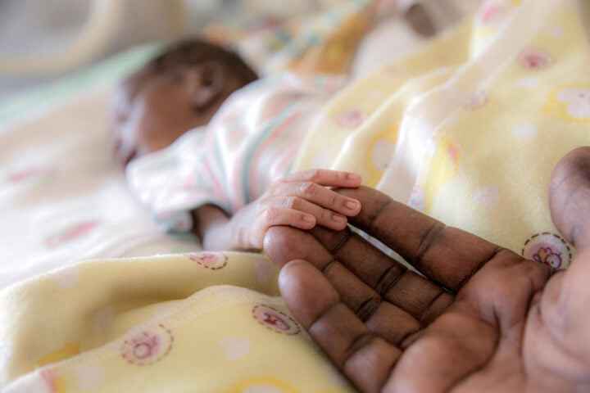
Tackling Child and Infant Mortality in Africa
10Alytics Global Hackathon 2024
30 November – 1 December 2024

Slide 2

Introduction

Slide 3

Introduction
General Overview
Child and infant mortality rates remain a critical issue in Africa, impeding progress toward several Sustainable Development Goals (SDGs), including Goal 3: Good Health and Well-being. By leveraging data-driven approaches, this hackathon aims to identify actionable insights, develop innovative solutions, and contribute to global efforts to reduce preventable deaths in children under five years of age.
Objective
The primary objective is to utilize the provided datasets to uncover patterns, correlations, and key drivers of child and infant mortality in African countries. Participants will propose data-driven strategies and interventions that policymakers, healthcare providers, and organizations can adopt to improve health outcomes for children.
Expected Outcomes
Participants are expected to:
Build visualizations that highlight trends in child and infant mortality rates.
Identify socioeconomic, healthcare, and environmental factors contributing to high mortality rates.
Propose actionable recommendations to address gaps in vaccination coverage, healthcare access, and maternal support.
Develop predictive models to identify regions and populations at higher risk.
Present insights in a format that is accessible to policymakers and stakeholders
We encourage participants to approach this case study with creativity, analytical rigor, and a focus on practical, implementable solutions. The insights derived from this analysis have the potential to inform policy, shape educational and economic strategies, and ultimately contribute to the reduction of child and infant mortality in Africa.

Slide 4

Data Overview
Data Overview
The datasets provided for this hackathon include:
Health Protection Coverage: Percentage of populations covered by health insurance.
Global Vaccination Coverage: Vaccination rates for various diseases among children.
Births Attended by Skilled Health Staff: The percentage of births assisted by skilled healthcare providers.
Maternal Deaths by Region: Estimated maternal deaths by region and year.
Child Mortality by Income Level: Under-five mortality rates across different income-level countries.
Infant Deaths: Annual number of infant deaths by country.
Youth Mortality Rates: Mortality rates for individuals under 15.
Causes of Death in Children Under Five: Breakdown of major causes of death among young children.

Slide 5
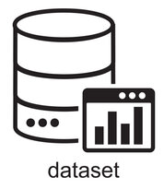
Datasets
Download Datasets HERE

Slide 6
Data Dictionary

Slide 7
Data Dictionary
1. Health Protection Coverage
Fields | Description
Entity | Name of the country or region.
Code | Country code (ISO 3-letter format).
Year | Year of observation.
Share of population covered by health insurance | Percentage of the population covered by health insurance.

Slide 8
Data Dictionary
2. Global Vaccination Coverage
Fields | Description
Entity | Name of the country or region.
Code | Country code (ISO 3-letter format).
Year | Year of observation.
BCG (% of one-year-olds immunized) | Percentage of one-year-olds immunized with BCG vaccine.
HepB3 (% of one-year-olds immunized) | Percentage of one-year-olds immunized with Hepatitis B vaccine.
Hib3 (% of one-year-olds immunized) | Percentage of one-year-olds immunized with Haemophilus influenzae B.
IPV1 (% of one-year-olds immunized) | Percentage of one-year-olds immunized with Inactivated Polio Vaccine.
MCV1 (% of one-year-olds immunized) | Percentage of one-year-olds immunized with Measles vaccine (1st dose).
PCV3 (% of one-year-olds immunized) | Percentage of one-year-olds immunized with Pneumococcal conjugate vaccine.
Pol3 (% of one-year-olds immunized) | Percentage of one-year-olds immunized with Polio vaccine (3rd dose).
RCV1 (% of one-year-olds immunized) | Percentage of one-year-olds immunized with Rubella vaccine.
RotaC (% of one-year-olds immunized) | Percentage of one-year-olds immunized with Rotavirus vaccine.
YFV (% of one-year-olds immunized) | Percentage of one-year-olds immunized with Yellow Fever vaccine.
DTP3 (% of one-year-olds immunized) | Percentage of one-year-olds immunized with Diphtheria, Tetanus, and Pertussis vaccine.

Slide 9
Data Dictionary
3. Births Attended by Health Staff
Fields | Description
Entity | Name of the country or region.
Code | Country code (ISO 3-letter format).
Year | Year of observation.
Births attended by skilled health staff (%) | Percentage of total births attended by skilled health staff.

Slide 10
Data Dictionary
4. Maternal Deaths by Region
Fields | Description
Entity | Name of the country or region.
Code | Country code (ISO 3-letter format).
Year | Year of observation.
Estimated maternal deaths | Estimated number of maternal deaths in the given year.

Slide 11
Data Dictionary
5. Child Mortality by Income Level
Fields | Description
Entity | Name of the country or region.
Code | Country code (ISO 3-letter format).
Year | Year of observation.
Under-five mortality rate | Number of deaths of children under five years per 100 live births.

Slide 12
Data Dictionary
6. Infant Deaths
Fields | Description
Entity | Name of the country or region.
Code | Country code (ISO 3-letter format).
Year | Year of observation.
Deaths - Sex: all - Age: 0 | Total number of infant deaths (age 0) for the given year.

Slide 13
Data Dictionary
7. Youth Mortality Rate
Fields | Description
Entity | Name of the country or region.
Code | Country code (ISO 3-letter format).
Year | Year of observation.
Under-fifteen mortality rate | Number of deaths per 1,000 live births for children under 15 years.

Slide 14
Data Dictionary
8. Causes of Death in Children Under Five
Fields | Description
IndicatorCode | Indicator code for the specific cause of death
Indicator | Description of the cause of death
ValueType | Type of the value (e.g., numeric, percentage)
ParentLocationCode | Code for the parent region
ParentLocation | Name of the parent region
Location | Name of the country
Type | Classification type
SpatialDimValueCode | Spatial dimension code for the country
Period | Year of data collection
FactValueNumericHigh | Upper bound of the estimated value
FactValueNumericLow | Lower bound of the estimated value
FactValueTranslationID | Translation ID for value
FactComments | Comments or notes related to the fact
Language | Language of the record

Slide 15
Tools & Presentation Criteria

Slide 16






Tools & Presentation Criteria
Tools to be used
Participants are free to use any visualization or analytical tool they prefer for analyzing the data in the case study.
Here are some examples of tools that can be used:
Data analysis: Excel, R, Python, SAS, Stata, SPSS
Data visualization: Tableau, Power BI, QlikView, ggplot2 (in R)
Presentation Criteria
Participants are free to use any tool to present their findings in the hackathon.
Here are some examples of tools that can be used for the presentation:
PowerPoint
Excel
Power BI
Tableau
Python
etc

Slide 17

Tools & Presentation Criteria
Presentation Criteria
Data Analysis: How well did the participant analyze the provided data? Were their findings insightful and relevant? Did they use appropriate statistical methods?
Visualizations:
Did the participant create clear and visually appealing data visualizations? Did they use the right types of charts and graphs to communicate their findings?
Interpretation:
Did the team effectively interpret their findings? Did they draw appropriate conclusions and insights from the data?
Creativity:
Did the participant approach the problem with a creative and innovative mindset? Did they think outside the box in their analysis and presentation?
Clarity:
Was the presentation clear and easy to understand? Did the participant communicate their findings effectively and concisely?
Impact:
Did the participant findings have a significant impact on the problem at hand? Did they provide valuable insights and recommendations for key stakeholders?
Technical Ability:
How well did the participant use the tools and technologies at their disposal? Were their methods sound and effective?
Area of Concentration
Provide your recommendation to the case study
Include the limitations of the dataset and how you think your analysis can be further enriched
Be ready to discuss your insights and share what you learned working on the datasets
All the best!!

